Slide 1
Exploratory Data Analysis (EDA)

Slide 2
At a high level, EDA is the practice of using visual and quantitative methods to understand and summarize a dataset without making any assumptions about its contents. It is a crucial step to take before diving into machine learning or statistical modeling because it provides the context needed to develop an appropriate model for the problem at hand and to correctly interpret its results.
EDA is valuable to the data scientist to certain that the results they produce are valid, correctly interpreted, and applicable to the desired business contexts.
Outside of ensuring the delivery of technically sound results, EDA also benefits business stakeholders by confirming they are asking the right questions and not biasing the investigation with their assumptions, as well as by providing the context around the problem to make sure the potential value of the data scientist’s output can be maximized.
As a bonus, EDA often leads to insights that the business stakeholder or data scientist wouldn’t even think to investigate but that can be hugely informative about the business.

Slide 3
Building an intuition for the data
EDA is a necessary step to take before more advanced modeling: data scientists need to become acquainted with the data first hand and develop an intuition for what is within it. This intuition is especially important for being able to quickly identify when things go wrong.
If, during EDA, I plot user product lifetime versus age and see that younger users tend to stay with a product longer, then, I would expect whatever model I build to have a term that would result in increased lifetime when age is decreased.
If I train a model that shows different behavior, I would quickly realize that I should investigate what is happening and make sure I didn’t make any mistakes.
Without EDA, glaring problems with the data or mistakes in the implementation of a model can go unnoticed for too long and can potentially result in decisions being made on wrong information.

Slide 4
EDA is about making sense out of data before getting ourselves busy with any model. Which makes total sense, right? Which model are we going to use if we don’t know our data yet?
Before there was a Machine Learning model, there was EDA…
This is a central aspect of Data Science, which sometimes gets overlooked. The first step of anything you do should be to know your data: understand it, get familiar with it. What are the answers you’re trying to get with that data? What variables are you using, and what do they mean? How does it look from a statistical perspective? Is data formatted correctly? Do you have missing values? And duplicated? What about outliers?
This concept gets even more important as you increase your data volume: imagine trying to parse through thousands or millions of registers and make sense out of them.

Slide 5
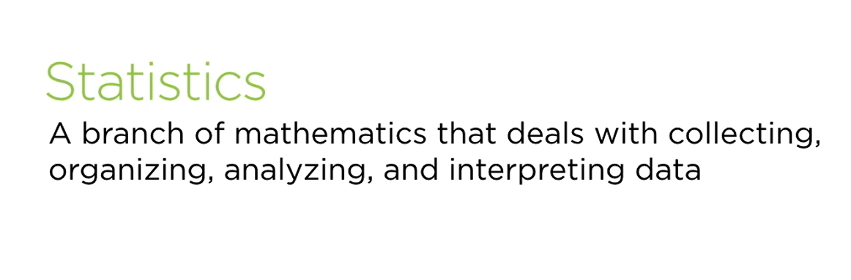

Slide 6
Qualitative and Quantitative Variables
Qualitative variables are the variables which take values x that cannot be ordered in a logical or natural way.
For example,• the color of the eye • the name of a political party, and
• the type of transport used to travel to work
Neither is there any reason to list blue eyes before brown eyes (or vice versa) nor does it make sense to list buses before trains (or vice versa).
Quantitative variables represent measurable quantities. The values which these variables can take can be ordered in a logical and natural way.
Examples of quantitative variables are
• size of shoes, • price for houses, • number of semesters studied, and
• weight or height of a person

Slide 7
Scale
Nominal scale : The values of a nominal variable cannot be ordered. Examples are the gender of a person (male–female) or the status of an application (pending–not pending).
Ordinal scale : The values of an ordinal variable can be ordered. However, the differences between these values cannot be interpreted in a meaningful way. For example, the possible values of education level (none–primary education–secondary education–university degree) can be ordered meaningfully, but the differences between these values can not be interpreted. Likewise, the satisfaction with a product (unsatisﬁed–satisﬁed–very satisﬁed) is an ordinal variable because the values this variable can take can be ordered, but the differences between “unsatisﬁed– satisﬁed” and “satisﬁed–very satisﬁed” cannot be compared in a numerical way.

Slide 8
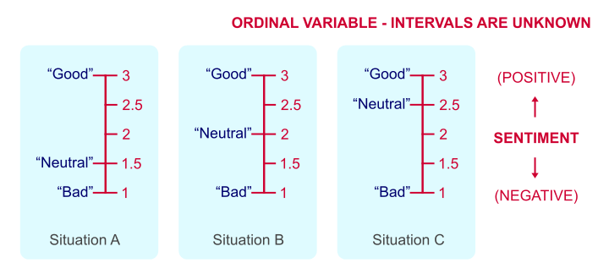
The proper treatment of ordinal features in machine learning is tricky. The two most common approaches are:
Treat them as continuous. The main downside here is that this technique ignores the fact that the differences in levels may not be similar.
Treat them as categorical. This option ignores the ordered nature of the variable.
However, if the effect or importance of that ordering is not that big or all that important, we then can be sure that we would not be overstating any effects.
The first method would not require any encoding. The second would.

Slide 9
Continuous scale: The values of a continuous variable can be ordered.Furthermore, the differences between these values can be interpreted in a meaningful way. For instance, the height of a person refers to a continuous variable because the values can be ordered (170 cm, 171 cm, 172 cm, …), and differences between these values can be compared (the difference between 170 and 171cm is the same as the difference between 171 and 172 cm). Sometimes, the continuous scale is divided further into subscales. While in the remainder of the book we typically do not need these classiﬁcations, it is still useful to reﬂect on them.
Interval scale: Only differences between values, but not ratios, can be interpreted.
An example for this scale would be temperature (measured in ◦C): the difference between −2 ◦C and 4 ◦C is 6◦C, but the ratio of 4/−2 =−2 does not mean that −4 ◦C is twice as cold as 2 ◦C. Ratio scale.
Ratio Scale: An example is speed: 60 km/h is 40 km/h more than 20 km/h. Moreover, 60 km/h is three times faster than 20 km/h because the ratio between them is 3.

Slide 10
Absolute scale : The absolute scale is the same as the ratio scale, with the exception that the values are measured in “natural” units.
An example is “number of semesters studied” where no artiﬁcial unit such as km/h or◦C is needed: the values are simply 1,2,3,... .

Slide 11
Data Collection
When collecting data, we may ask ourselves how to facilitate this in detail and how much data needs to be collected. In general, we can think of collecting data either on all subjects of interest, such as in a national census, or on a representative sample of the population.
Most commonly, we gather data on a sample and then draw conclusions about the population of interest.
A sample might either be chosen by us or obtained through third parties (hospitals, government agencies), or created during an experiment. This depends on the context as described below.
Survey. A survey typically (but not always) collects data by asking questions (in person or by phone) or providing questionnaires to study participants (as a printout or online). For example, an opinion poll before a national election provides evidence about the future government: potential voters are asked by phone which party they are going to vote for in the next election; on the day of the election, this information can be updated by asking the same question to a sample of voters who have just delivered their vote at the polling station (so-called exit poll).

Slide 12
A behavioral research survey may ask members of a community about their knowledge and attitudes towards drug use. For this purpose, the study coordinators can send people with a questionnaire to this community and interview members of randomly selected households.
Ideally, a survey is conducted in a way which makes the chosen sample representative of the population of interest.
If a marketing company interviews people in a pedestrian zone to ﬁnd their views about a new chocolate bar, then these people may not be representative of those who will potentially be interested in this product.
Similarly, if students are asked to ﬁll in an online survey to evaluate a lecture, it may turn out that those who participate are on average less satisﬁed than those who do not. Survey sampling is a complex topic on its own.

Slide 13
Experiment. Experimental data is obtained in “controlled” settings. This can mean many things, but essentially it is data which is generated by the researcher with full control over one or many variables of interest.
For instance, suppose there are two competing toothpastes, both of which promise to reduce pain for people with sensitive teeth. If the researcher decided to randomly assign toothpaste A to half of the study participants, and toothpaste B to the other half, then this is an experiment because it is only the researcher who decides which toothpaste is to be used by any of the participants. It is not decided by the participant. The data of the variable toothpaste is controlled by the experimenter.
Consider another example where the production process of a product can potentially be reduced by combining two processes. The management could decide to implement the new process in three production facilities, but leave it as it is in the other facilities. The production process for the different units (facilities) is therefore under control of the management. However, if each facility could decide for themselves if they wanted a change or not, it would not be an experiment because factors not directly controlled by the management, such as the leadership style of the facility manager, would determine which process is chosen.

Slide 14
Observational Data : Observational data is data which is collected routinely, without a researcher designing a survey or conducting an experiment.
Suppose a blood sample is drawn from each patient with a particular acute infection when they arrive at a hospital. This data may be stored in the hospital’s folders and later accessed by a researcher who is interested in studying this infection.
Or suppose a government institution monitors where people live and move to. This data can later be used to explore migration patterns.
Primary and Secondary Data : Primary data is data we collect ourselves, i.e. via a survey or experiment. Secondary data, in contrast, is collected by someone else. For example, data from a national census, publicly available databases, previous research studies, government reports, historical data, and data from the internet, among others, are secondary data.

Slide 15
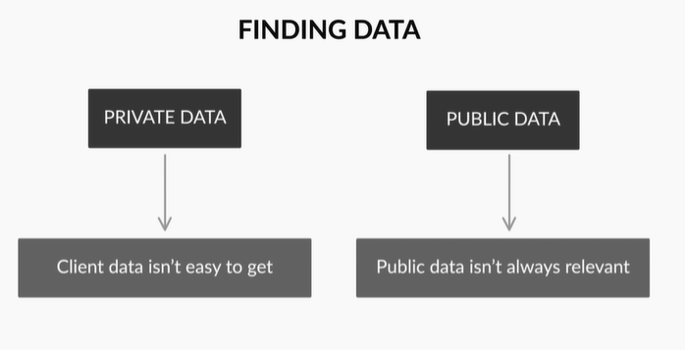
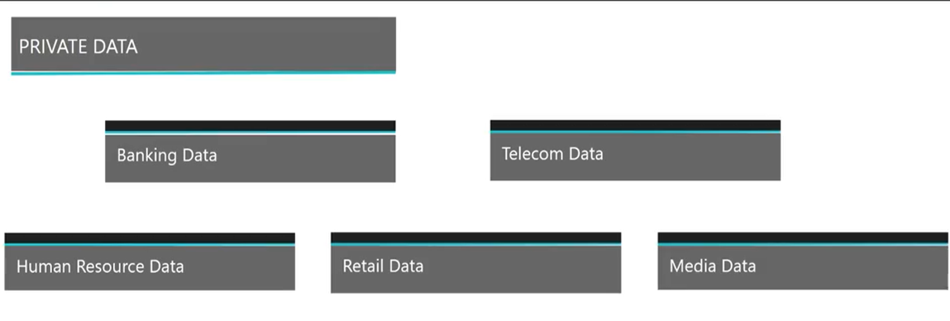

Slide 16
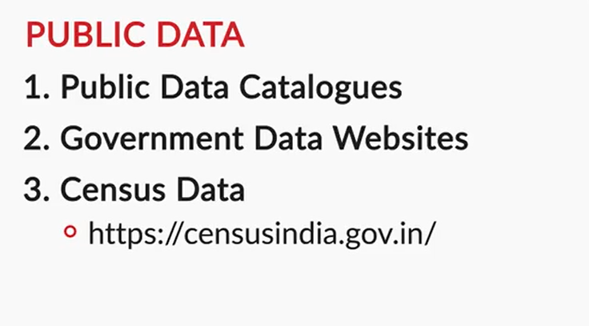


Slide 17
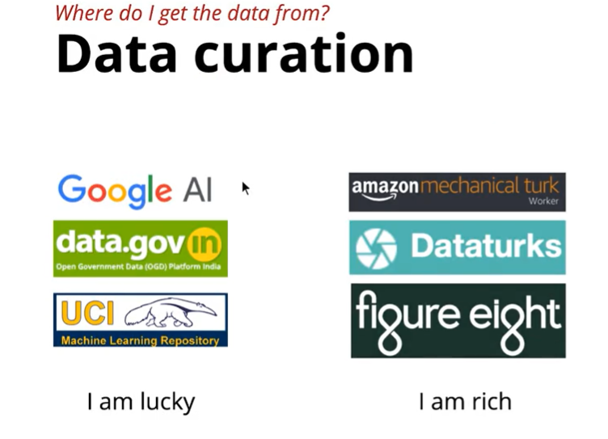
Create Labelled Data
Wiki Data
I am smart

Slide 18
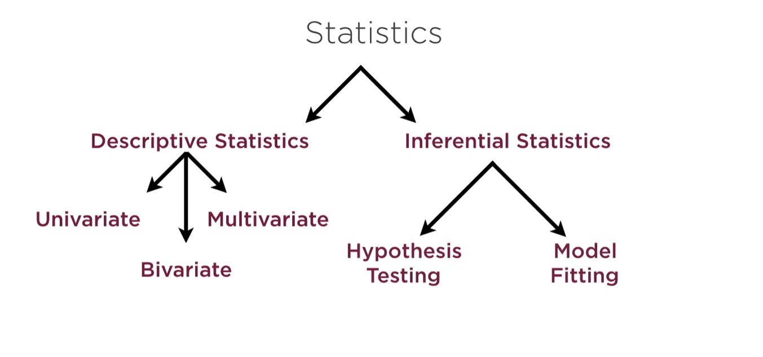

Slide 19
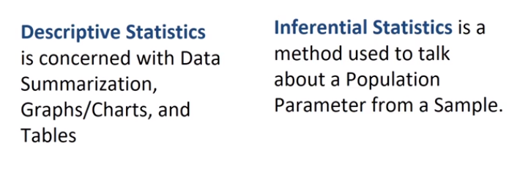
To Check What has Already happened in Data
To Check What might happen in Data
To Explain What We have Found in Data !!!
slicing and dicing
calculating summary statistics
basic plotting for numerical and categorical data
basic visualization

Slide 20
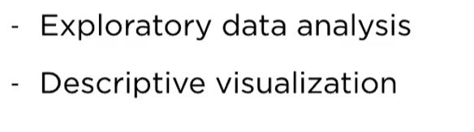
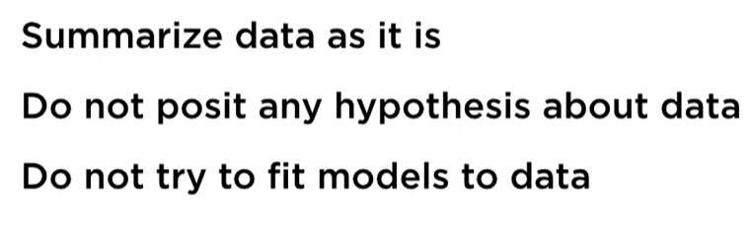
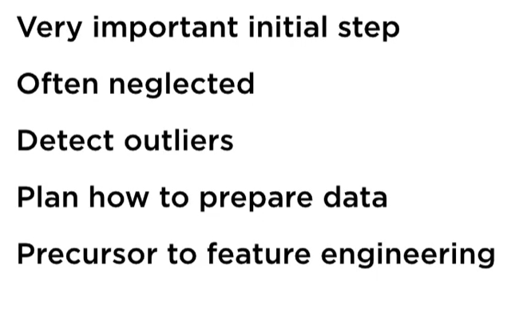
Descriptive Statistics

Slide 21


Slide 22
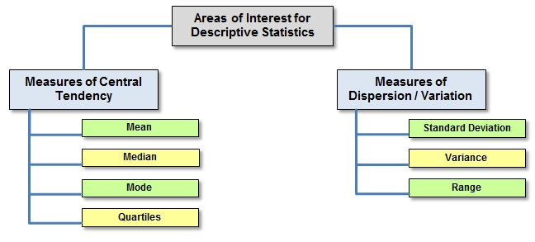

Slide 23


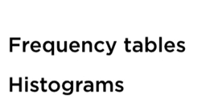
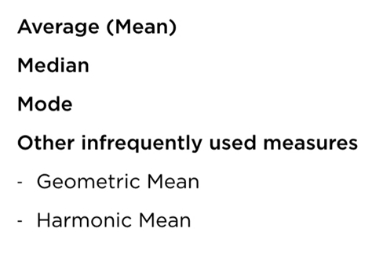

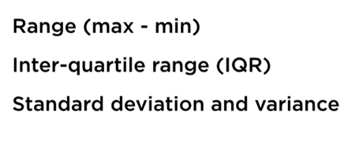

Slide 24
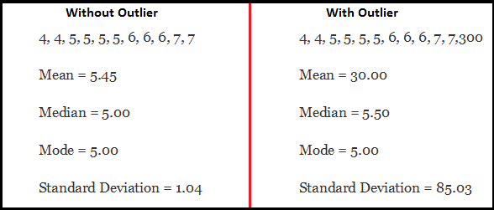
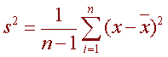
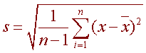
http://www.ltcconline.net/greenl/courses/201/descstat/mean.htm
Variance
Standard Deviation
Median : The middle data point or 50th Percentile Value
Mode : The most common value occurring in data

Slide 25
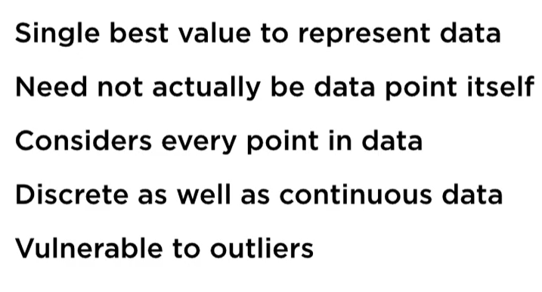
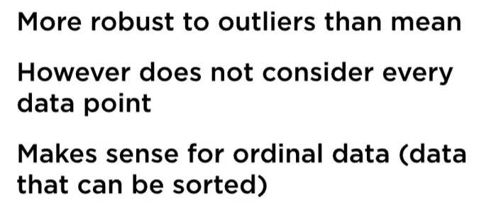
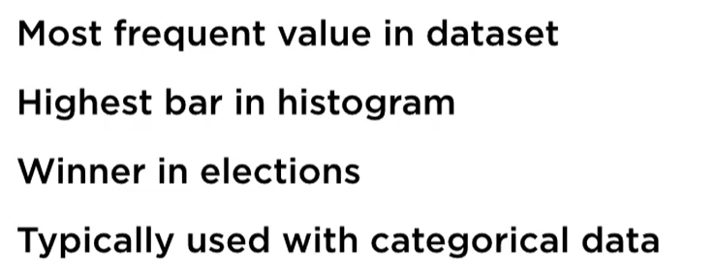
Mean
Mode
Median

Slide 26
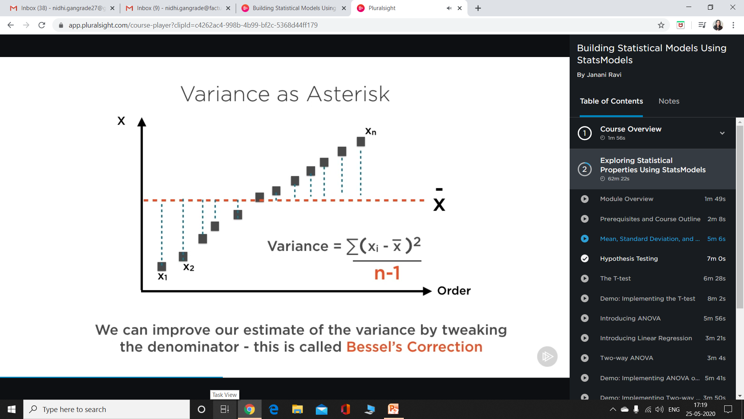
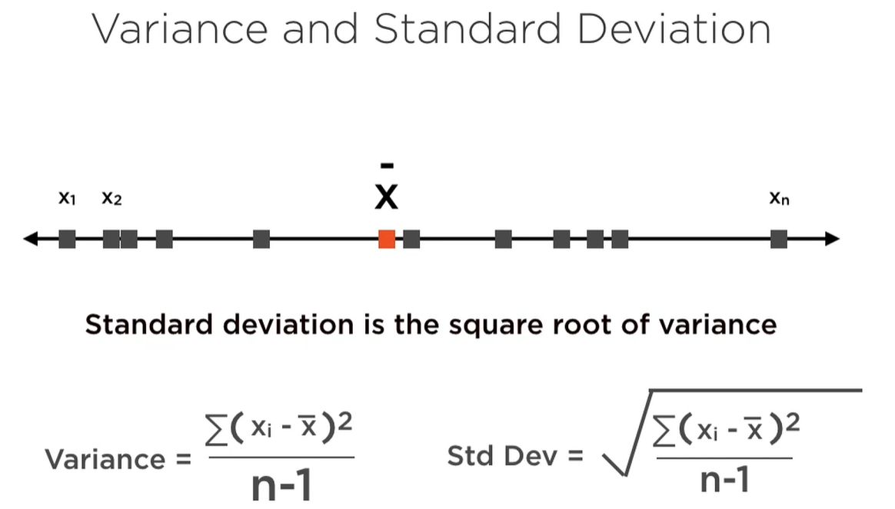

Slide 27
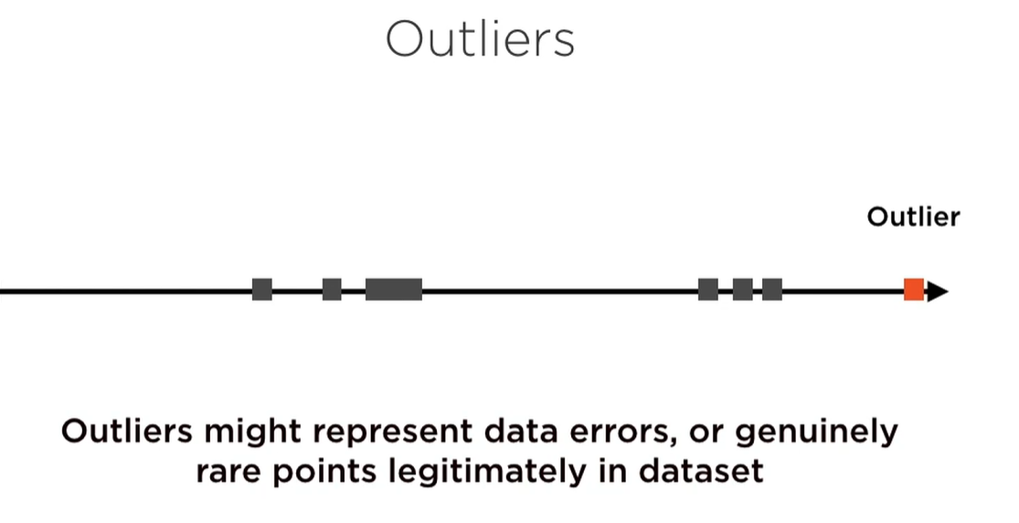

Slide 28
Outliers are observations in a dataset that don’t fit in some way.
Perhaps the most common or familiar type of outlier is the observations that are far from the rest of the observations or the center of mass of observations.
This is easy to understand when we have one or two variables and we can visualize the data as a histogram or scatter plot, although it becomes very challenging when we have many input variables defining a high-dimensional input feature space.
In this case, simple statistical methods for identifying outliers can break down, such as methods that use standard deviations or the interquartile range.
It can be important to identify and remove outliers from data when training machine learning algorithms for predictive modeling.
Outliers can skew statistical measures and data distributions, providing a misleading representation of the underlying data and relationships. Removing outliers from training data prior to modeling can result in a better fit of the data and, in turn, more skillful predictions.

Slide 29
Percentile & Quartiles
A percentile is a measure used in statistics indicating the value below which a given percentage of observations in a group of observations falls.
For example, the 20th percentile is the value below which 20% of the observations may be found. Similarly, 80% of the observations are found above the 20th percentile.
The 25th percentile is also known as the first quartile (Q₁), the 50th percentile as the median or second quartile (Q₂), and the 75th percentile as the third quartile (Q₃).

Slide 30
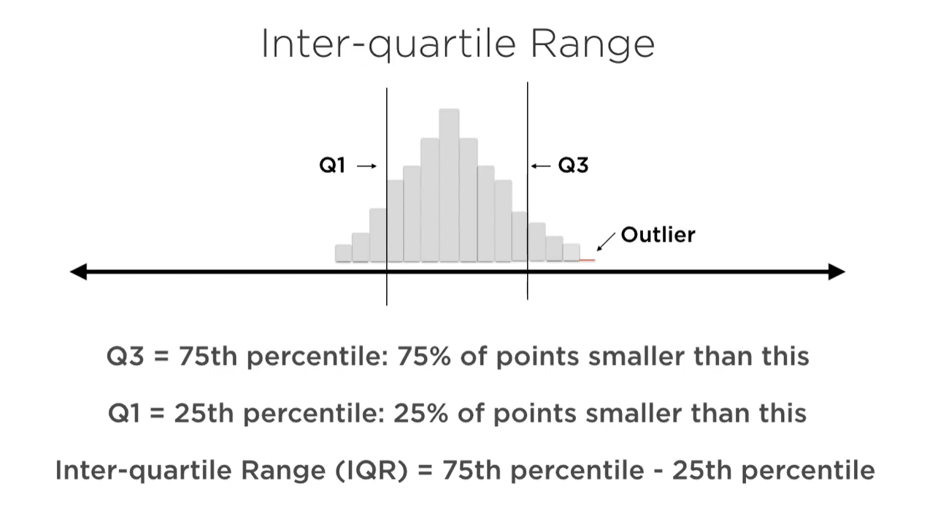

Slide 31
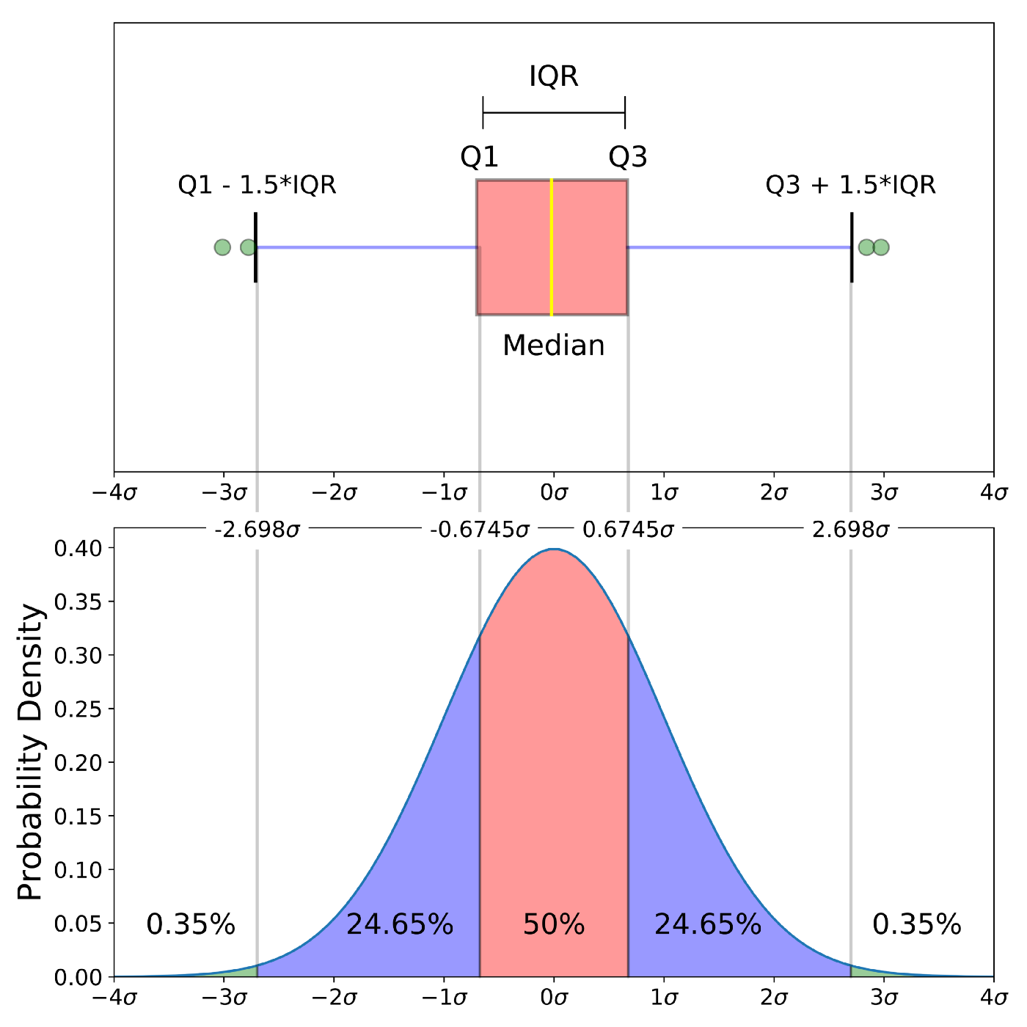

Slide 32
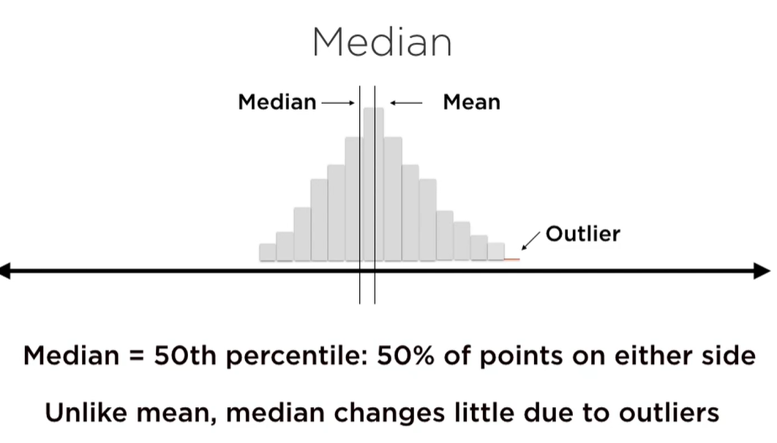

Slide 33
Lying with Stats

Slide 34
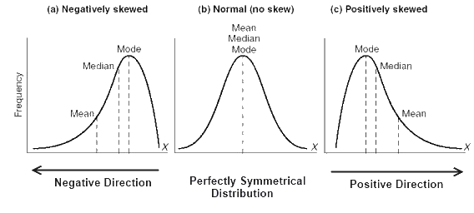
Biased Averages
Understanding the terminology

Slide 35
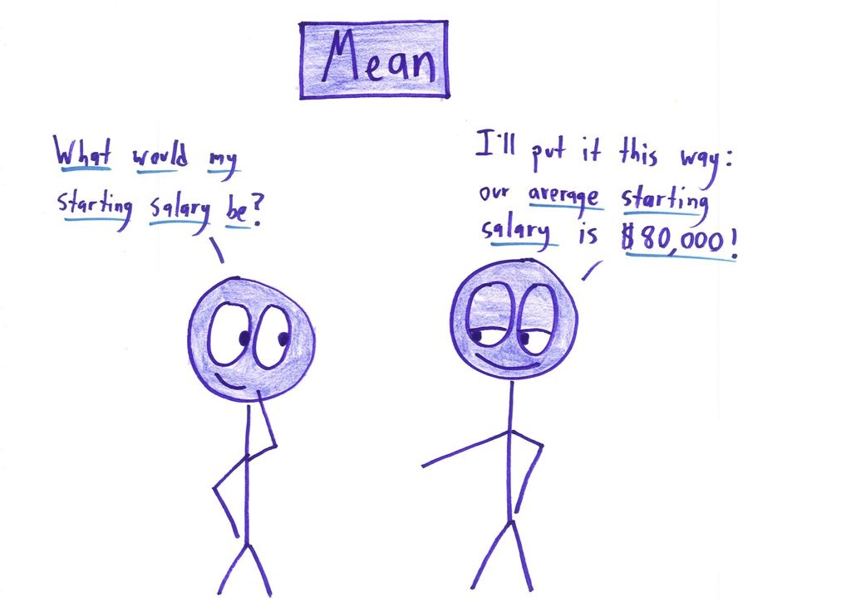
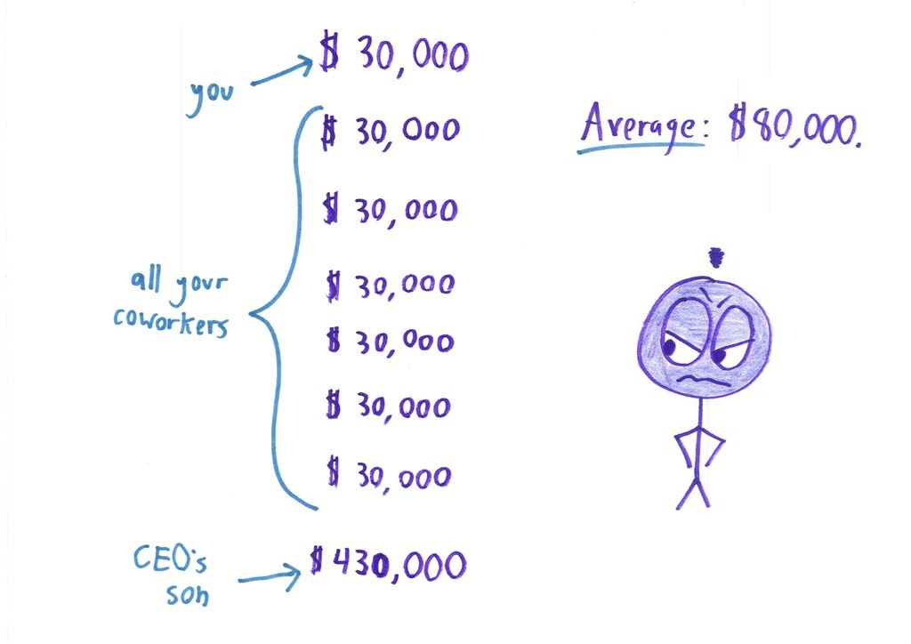
2. Lying with Mean Average
Abnormally high or low numbers in the data set can significantly swing the average.

Slide 36
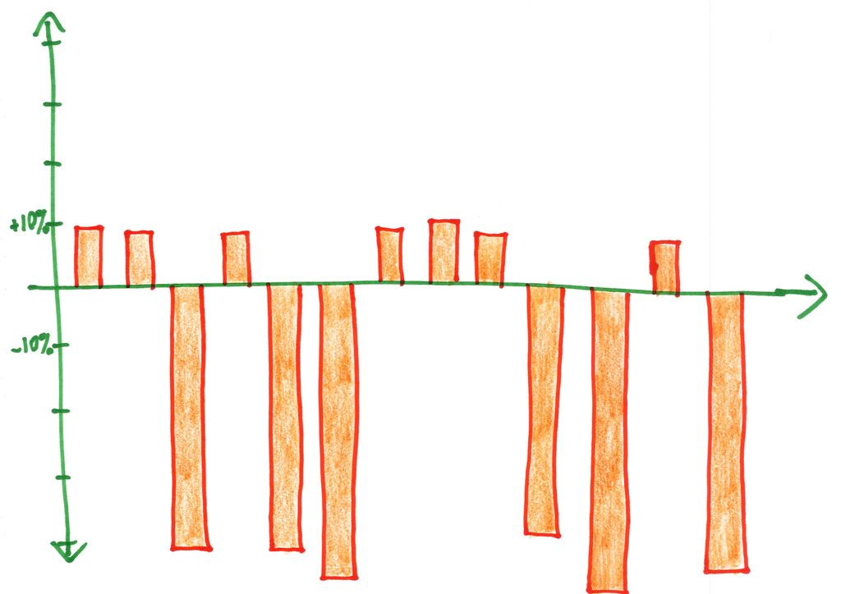
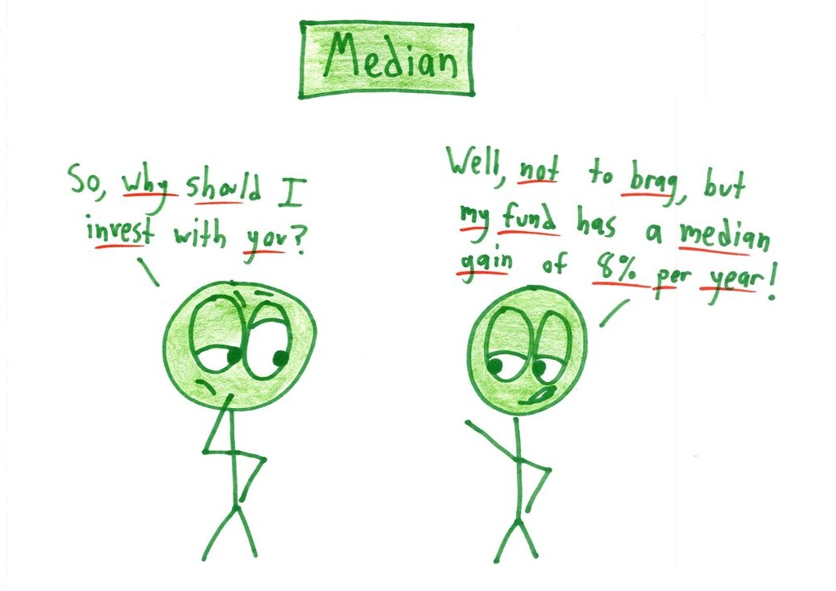
3. Lying with Median Average

Slide 37
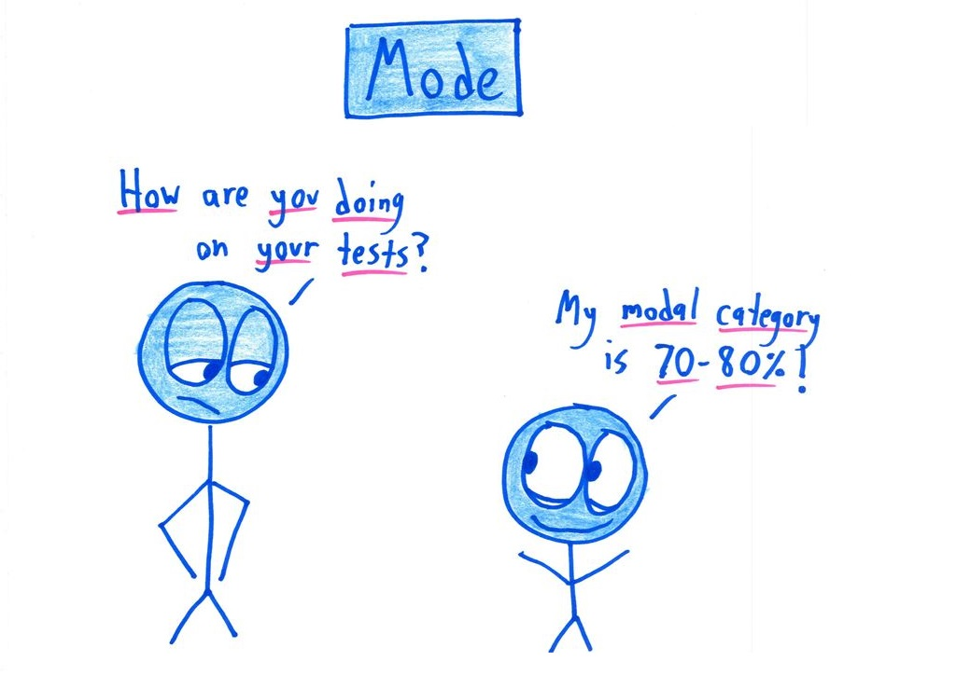
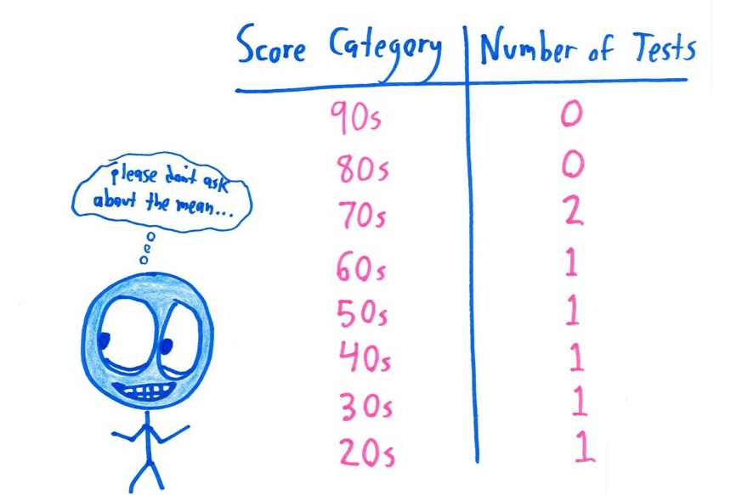
4. Lying with Mode Average

Slide 38
Deceptive Summary Statistics

Slide 39
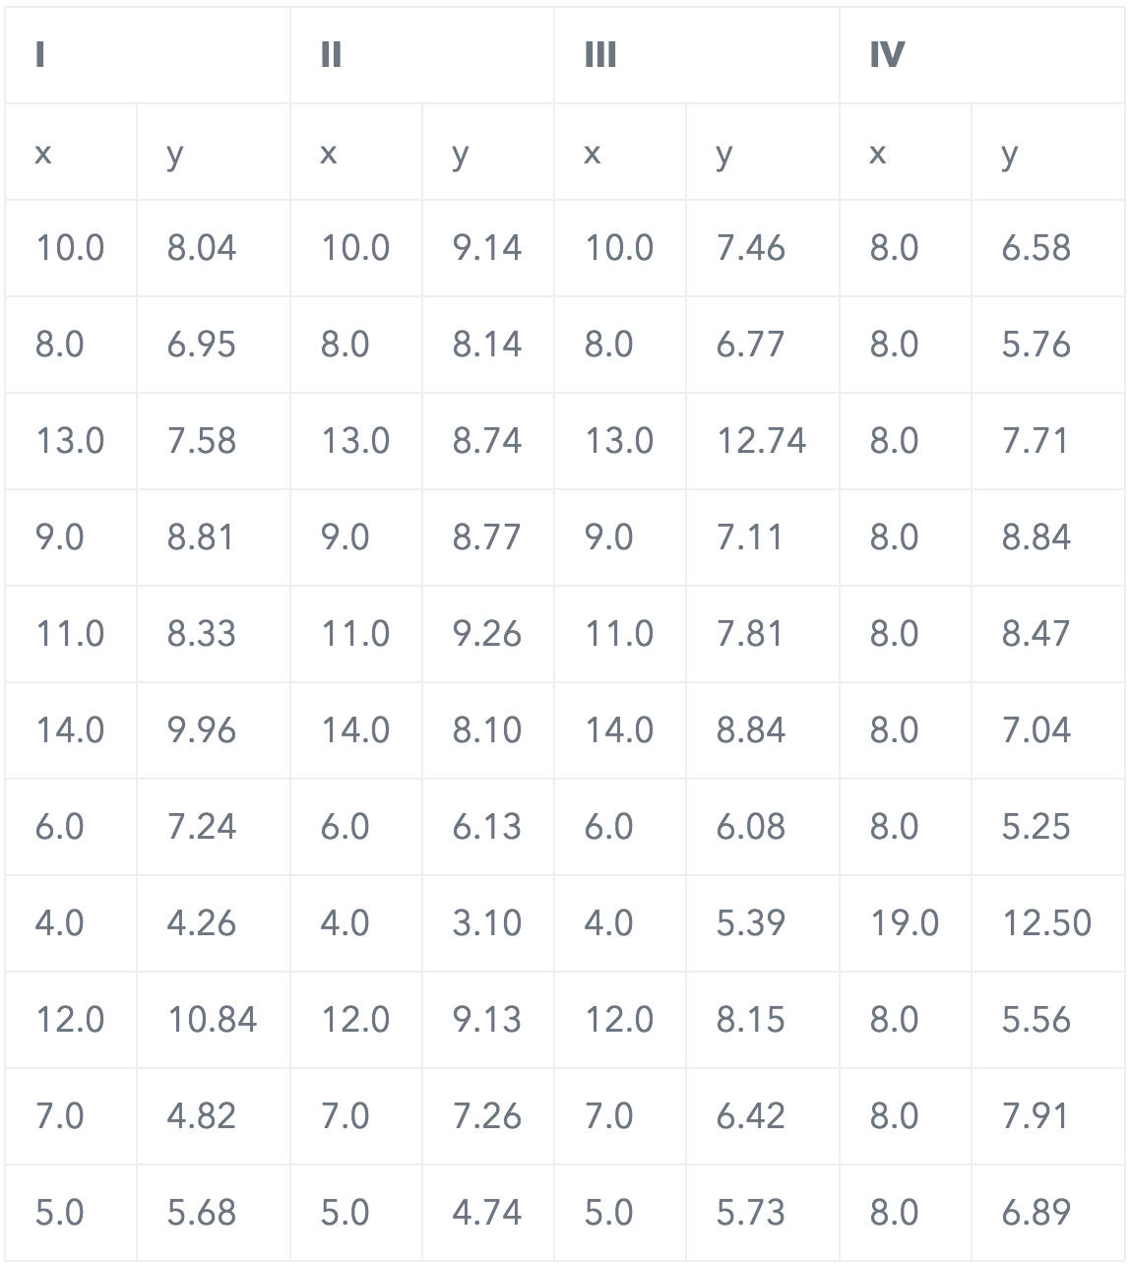
Anscombe’s Quartet
The average x value is 9 for each dataset
The average y value is 7.5 for each dataset
The variance for x is 11 and the variance for y is 4.12
The correlation between x and y is 0.816 for each dataset
A linear regression (line of best fit) for each dataset follows the equation y = 0.5x + 3

Slide 40
Anscombe’s Quartet
The average x value is 9 for each dataset
The average y value is 7.50 for each dataset
The variance for x is 11 and the variance for y is 4.12
The correlation between x and y is 0.816 for each dataset
A linear regression (line of best fit) for each dataset follows the equation y = 0.5x + 3

Slide 41
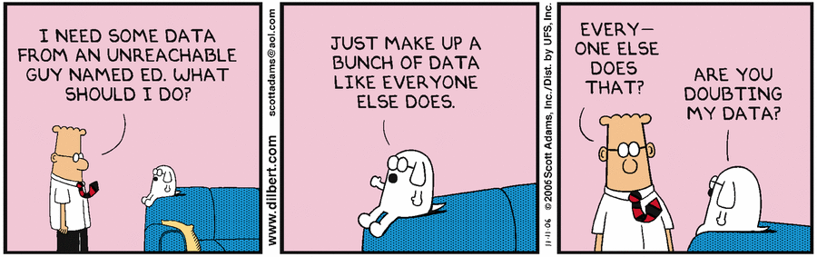
Biased Datasets
Small dataset
Biased sampling

Slide 42
Biased Datasets
Small dataset
The more items of information you put into your data set, the more likely it is to end up with accurate averages. By using a set of just 5 -10 data points, you can produce results that don't accurately show the real picture.

Slide 43

2. Biased sampling
Drawing conclusions from a set of data that isn’t representative of the population you’re trying to understand

Slide 44

Showing Correlation
as Causation
Just because there is a correlation between two variables, does not imply that either one causes the other. The "cause" might be a third variable that is not immediately obvious.

Slide 45
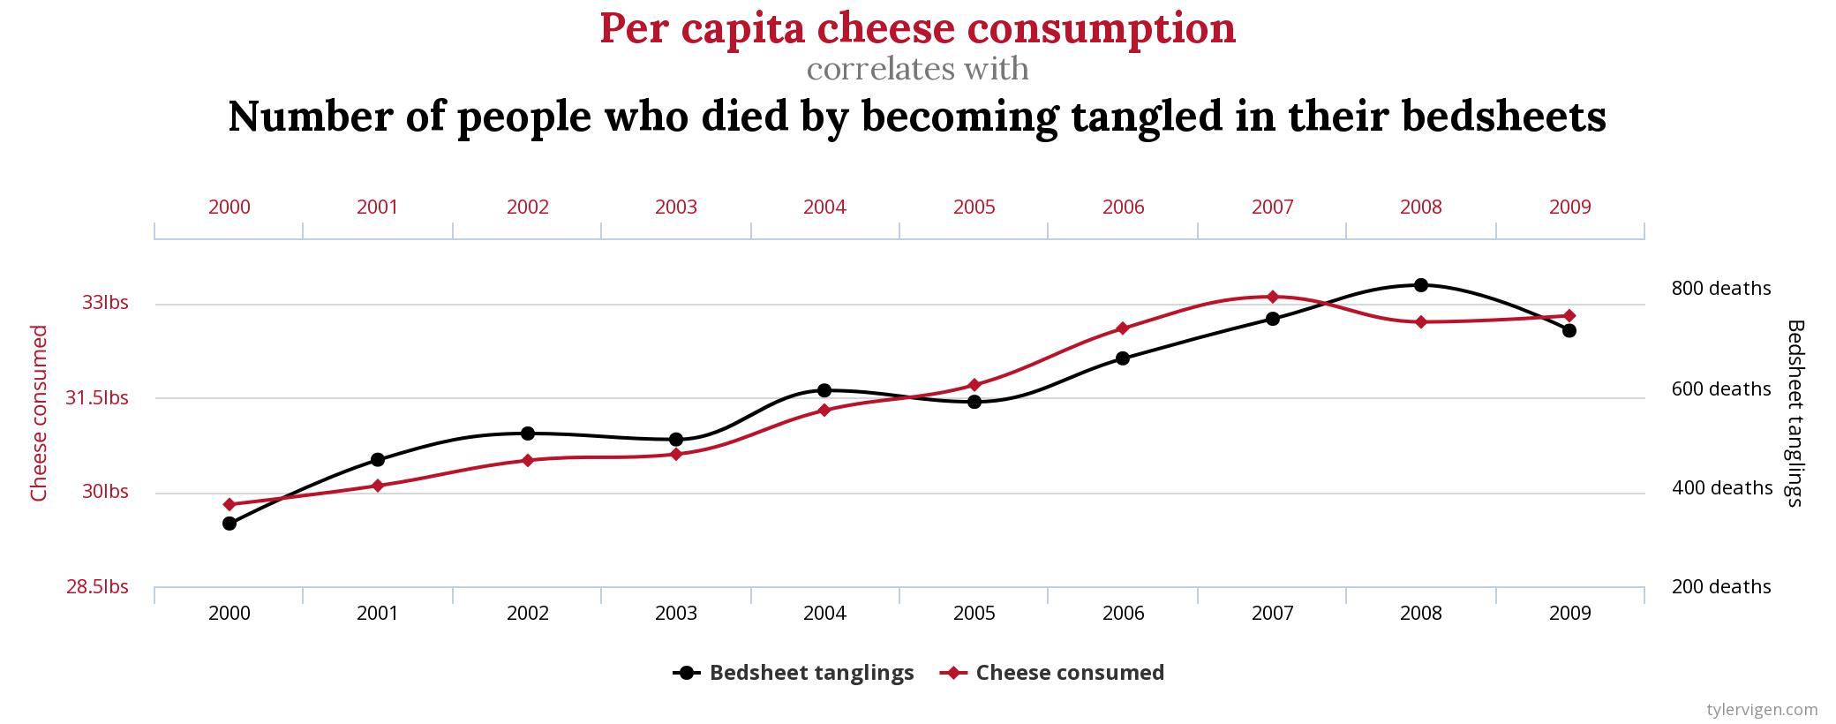
Correlation between random events

Slide 46
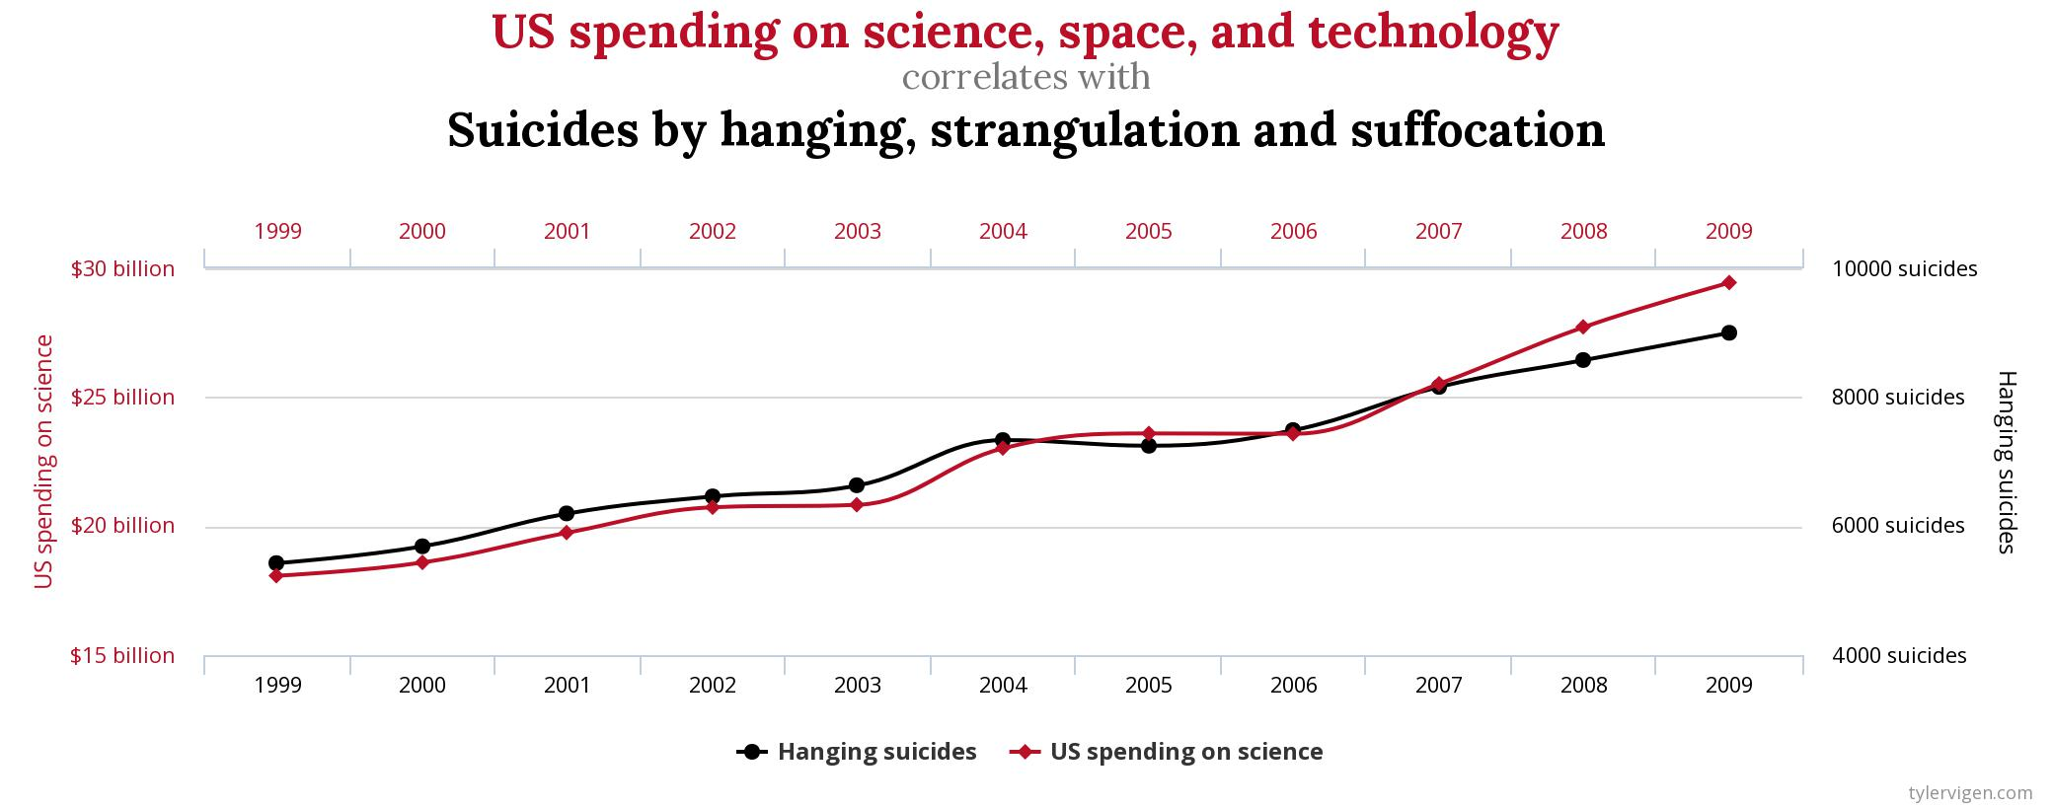
Correlation between random events

Slide 47
Univariate Analysis
Exploring variables one by one. Method to perform uni-variate analysis will depend on whether the variable type is categorical or continuous.
Continuous Variables:- In case of continuous variables, we need to understand the central tendency and spread of the variable. We can visualise those using Histogram or Distribution Plots.
Categorical Variables:- We can use Pie Chart or Count/Bar Plots.

Slide 48
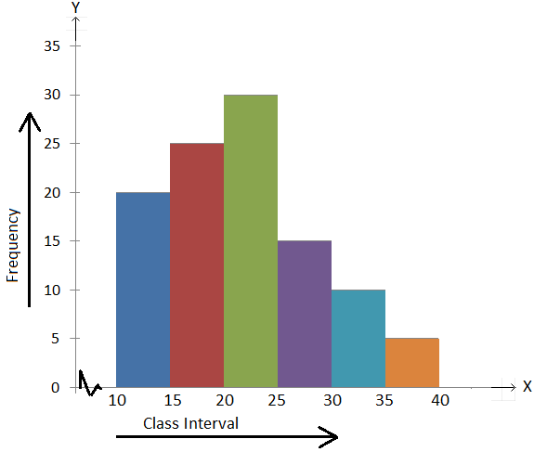
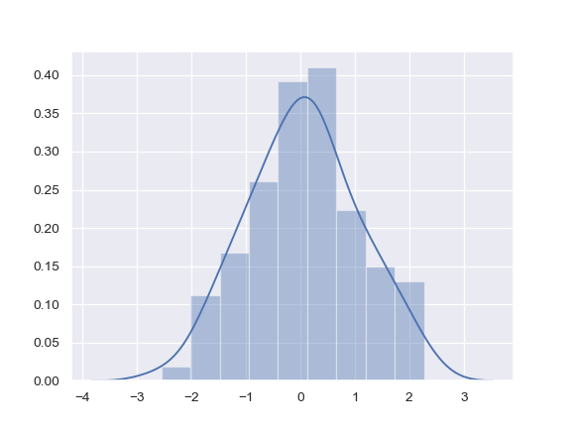
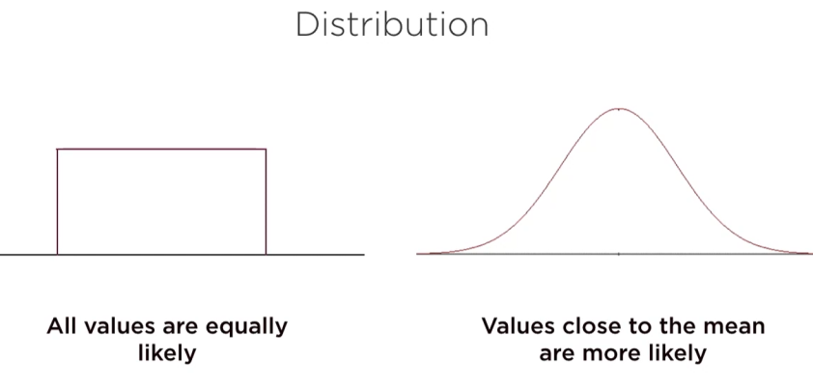
Histogram
If a variable consists of a large number of different values, the number of categories used to construct bar charts will consequently be large too.
A bar chart may thus not give a clear summary when applied to a continuous variable. Instead, a histogram is the appropriate choice to represent the distribution of values of continuous variables.

Slide 49
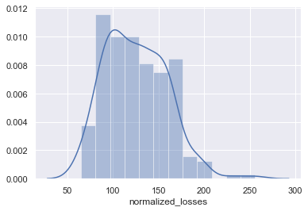
Kernel Density Plots (KDE)
A disadvantage of histograms is that continuous data is categorized artiﬁcially.
The choice of the class intervals is crucial for the ﬁnal look of the graph. A more elegant way to deal with this problem is to smooth the histogram in the sense that each observation may contribute to different classes with different weights, and the distribution is represented by a continuous function rather than a step function.

Slide 50
Pie Chart
Pie charts are another option to visualize the absolute and relative frequencies of nominal and ordinal variables. A pie chart is a circle partitioned into segments, where each of the segments represents a category. The size of each segment depends upon the relative frequency and is determined by the angle f j · 360◦.
Bar Chart
A bar chart or bar graph is a chart or graph that presents categorical data with rectangular bars with heights or lengths proportional to the values that they represent. The bars can be plotted vertically or horizontally. A vertical bar chart is sometimes called a column chart.

Slide 51
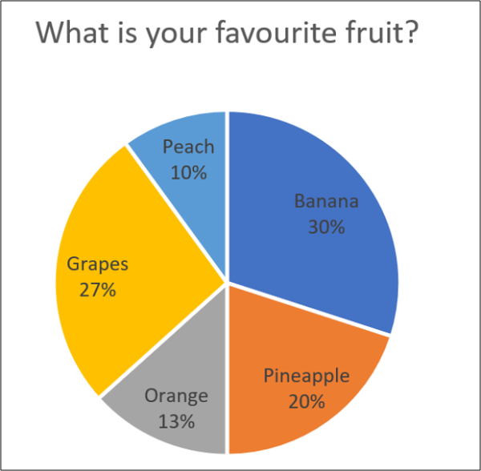
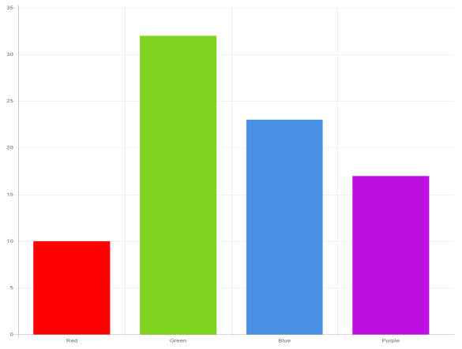
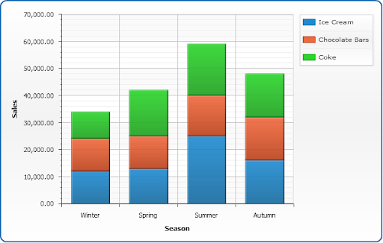
A stacked bar chart, also known as a stacked bar graph, is a graph that is used to break down and compare parts of a whole.
Each bar in the chart represents a whole, and segments in the bar represent different parts or categories of that whole.

Slide 52
Bi-variate Analysis
Bi-variate Analysis finds out the relationship between two variables.
Here, we look for association and disassociation between variables at a pre-defined significance level.
We can perform bi-variate analysis for any combination of categorical and continuous variables. The combination can be: Categorical & Continuous and Continuous & Continuous. Different methods are used to tackle these combinations during analysis process.
Let’s understand the possible combinations in detail:
Continuous & Continuous: While doing bi-variate analysis between two continuous variables, we should look at scatter plot. It is a nifty way to find out the relationship between two variables. The pattern of scatter plot indicates the relationship between variables. The relationship can be linear or non-linear.

Slide 53
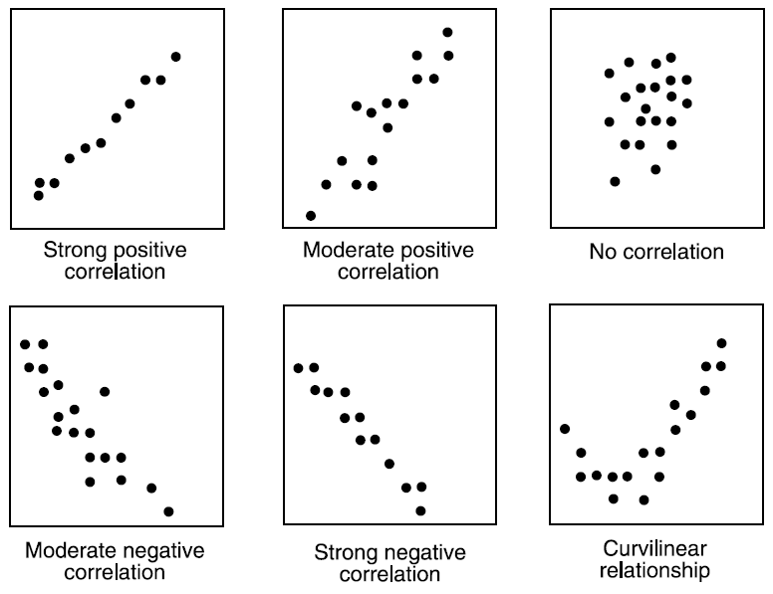

Slide 54
Scatter plot shows the relationship between two variable but does not indicates the strength of relationship amongst them.
To find the strength of the relationship, we use Correlation
Correlation varies between -1 and +1
-1: perfect negative linear correlation
+1:perfect positive linear correlation and 0: No correlation
Pearson Correlation can be derived using following formula:
Correlation = Covariance(X,Y) / SQRT( Var(X)* Var(Y))
The correlation coefﬁcient is independent of the units of measurement of X and Y. For example, if someone measures the height and weight in meters and kilograms respectively and another person measures them in centimeters and grams, respectively, then the correlation coefﬁcient between the two sets of data will be the same.

Slide 55
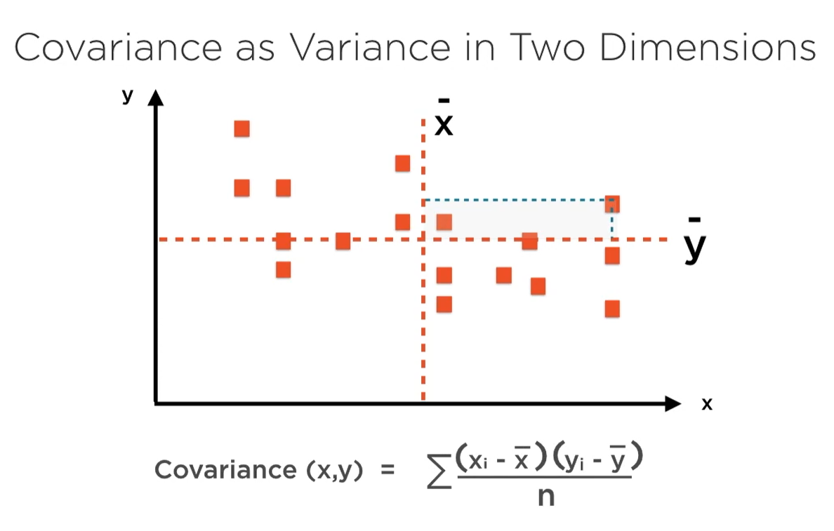
Covariance
The covariance between X and Y is deﬁned as ̺ = Cov(X,Y) = E[(X −E(X))(Y −E(Y))]
The covariance is positive if, on average, larger values of X correspond to larger values of Y; it is negative if, on average, greater values of X correspond to smaller values of Y.

Slide 56
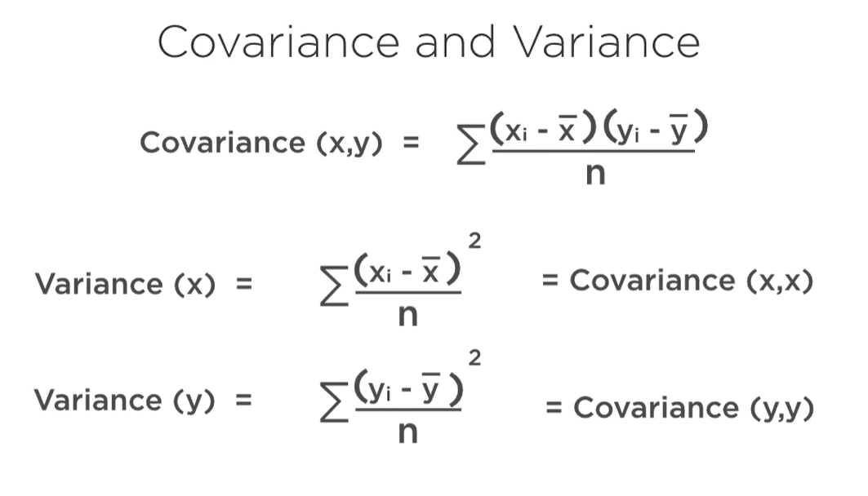

Slide 57
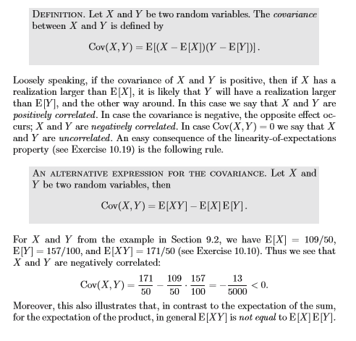

Slide 58
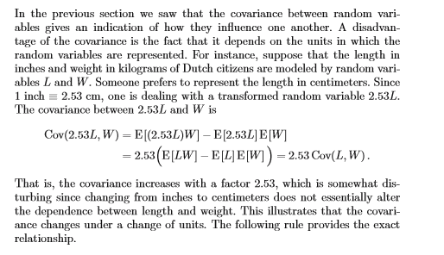

Slide 59


Slide 60


Slide 61


Slide 62


If X and Y are independent, they are also uncorrelated.
However, if they are uncorrelated then they are not necessarily independent.
If the variables have a non-linear relationship, you can measure the correlation using Spearman Correlation Coefficient. It can also be used with ordinal categorical variables.

Slide 63

Which correlation metric should you use?

Slide 64

Pearson Correlation Coefficient calculated as
r = Pearson Correlation Coefficient
n = number of observations ∑xy = sum of the products of x and y values ∑x = sum of x values ∑y = sum of y values ∑x2= sum of squared x values ∑y2= sum of squared y values

Slide 65

Spearman’s Correlation Coefficient
It tries to determine the strength and the direction of the monotonic relationship which exists between two ordinal or continuous variables.
In a monotonic relationship two variables tend to change together but not with the constant rate. It’s calculated on the ranked values of the variables rather than on the raw data.

Slide 66

Spearman rank correlation coefficient
ρ= Spearman rank correlation coefficient di= the difference between the ranks of corresponding variables n= number of observations

Slide 67

Pearson and Spearman correlation coefficient can take values from -1 to 1.
(i) If one variable increases with the other variable at the consistent rate then Pearson coefficient would be 1, which results in a perfect line. In this case Spearman coefficient would also be 1.
(ii) If one variable increases with the other variable but not with the consistent rate then Pearson coefficient would be positive but less than 1. In this case Spearman coefficient would be still 1.

Slide 68


(iv) If the relationship between the variables is a perfect line but with a decreasing relationship then both the coefficients would be -1.
(iii) If the relationship is random then both the coefficients would be near 0.
(iv) If the relationship between the variables is a perfect line but with a decreasing relationship then both the coefficients would be -1

Slide 69
(v) If the relationship between two variables is such that one variable decreases when the other increases but not with the consistent rate, then Pearson coefficient would be negative but greater than -1. Spearman coefficient would be -1 in this case.
Pearson correlation describes linear relationships and spearman correlation describes monotonic relationships. A scatter plot would be helpful to visualize the data and understand which correlation coefficient should be used.
Other way of doing is to apply both the methods and check which is performing well. For instance if results show spearman correlation coefficient is greater than Pearson coefficient, it means our data has monotonic relationships and not linear.

Slide 70

Point Biserial Correlation and how it is computed:
The point biserial correlation coefficient is the same as the Pearson correlation coefficient used in linear regression (measured from -1 to 1). The only difference is we are comparing dichotomous data to continuous data instead of continuous data to continuous data. From this point on let’s assume that our dichotomous data is composed of items from two groups (group 0 and group 1) and the continuous data as “y”. The coefficient is computed by the formula below:
Where:
M0 = the mean of the data from group 0.
M1 = the mean of the data from group 1.
Sy = the standard deviation of the continuous data.
n0 = the number of items in group 0.
n1 = the number of items in group 1.
n = the number of items in both groups together (aka the total rows in the data set).

Slide 71
In statistics, the phi coefficient (or mean square contingency coefficient and denoted by φ or r_{φ}) is a measure of association for two binary variables. Introduced by Karl Pearson, this measure is similar to the Pearson correlation coefficient in its interpretation. In fact, a Pearson correlation coefficient estimated for two binary variables will return the phi coefficient.
The phi coefficient is related to the chi-squared statistic for a 2×2 contingency table.
 | y = 1 | y = 0 | total
x = 1 | n11 | n10 | n1-
x = 0 | n01 | n00 | n0-
total | n-1 | n-0 | n
where n₁₁, n₁₀, n₀₁, n₀₀, are non-negative counts of numbers of observations that sum to n, the total number of observations. The phi coefficient that describes the association of x and y is
Phi= sqrt(Chi)/ n
= (n11n00- n01n10)/ sqrt( n1-.n0-.n-1.n-0)

Slide 72

χ² is the chi-square statistic,
N is the total number of cases or observations in our analysis/study,
C is the contingency coefficient.
Understanding Contingency Coefficient Values:
The contingency coefficient helps us decide if variable b is ‘contingent’ on variable a. However, it is a rough measure and doesn’t quantify the dependence exactly; It can be used as a rough guide:
If C is near zero (or equal to zero) you can conclude that your variables are independent of each other; there is no association between them.
If C is away from zero there is some relationship; C can only take on positive values.
The larger the table your chi-squared coefficient is calculated from, the closer to 1 a perfect association will approach. That’s why some statisticians suggest using the contingency coefficient only if you’re working with a 5 by 5 table or larger.
A contingency coefficient is particularly informative if you’re working with a large sample, and you don’t need to find out if an association is complete or not—just whether or not the association exists.
Other alternative measures of association include the phi coefficient (which has the same weak point as our C; never reaching one), and Cramers V. Cramers V is often preferred because with perfect association, it becomes exactly 1 no matter how large the table.

Slide 73
Categorical & Continuous:
While exploring relation between categorical and continuous variables, we can draw box plots for each level of categorical variables.
If levels are small in number, it will not show the statistical significance.
To look at the statistical significance we can perform Z-test, T-test or ANOVA.
Z-Test/ T-Test:- Either test assess whether mean of two groups are statistically different from each other or not.
If the probability of Z is small then the difference of two averages is more significant.
The T-test is very similar to Z-test but it is used when number of observation for both categories is less than 30.
Categorical & Categorical:
To find the relationship between two categorical variables, we can use Bar/ Stacked Bar plot or chi-square test.

Slide 74
Continuous & Categorical
Continuous Variables
Countplot
Boxplot
Stripplot
Swarmplot
Barplot
Catplot etc..
Scatterplot (Bi Variate)
Jointplot(Bi Variate)
Pairplot(Multi Variate)
Heatmap etc..

Slide 75


Box Plots - Displays the spread of the data. Used to visualize the variance in the data, as well as to find information on what proportion of the data is above and below the median value.

Slide 76


Strip & Swarm Plots

Slide 77


BIVARIATE DISTRIBUTIONS
Seaborn jointplot(bi variate) & pairplot(multi variate)

Slide 78



Slide 79

Seaborn Heat map
Correlation Between Variables

Slide 80
References
http://www.tylervigen.com/spurious-correlations
https://www.mojologic.com.au/numbers-dont-lie/
https://www.wikihow.com/Lie-with-Statistics
https://venngage.com/blog/misleading-graphs/
https://news.nationalgeographic.com/2015/06/150619-data-points-five-ways-to-lie-with-charts/
https://www.statisticshowto.datasciencecentral.com/misleading-graphs/
https://www.mediamatters.org/research/2012/10/01/a-history-of-dishonest-fox-charts/190225
https://heapanalytics.com/blog/data-stories/anscombes-quartet-and-why-summary-statistics-dont-tell-the-whole-story
https://www.geckoboard.com/learn/data-literacy
https://mathwithbaddrawings.com/2016/07/13/why-not-to-trust-statistics/
https://en.wikipedia.org/wiki/Simpson%27s_paradox
https://en.wikipedia.org/wiki/Anscombe%27s_quartet
How to Lie with Statistics by Darrell Huff

Slide 81
Happy Learning
Thank You
References: Multiple E-Books/Sources

